Slide 1
Teck Ghee Arc Outdoor

Slide 2
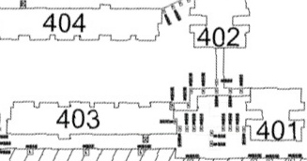
Outdoor 401,402,403 and 402,404 Linkway

Slide 3
404
402
403
401

Slide 4

Outdoor 403, 405 Linkway

Slide 5
405
403

Slide 6
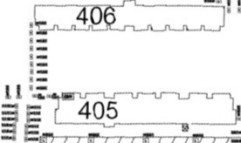
Outdoor 405, 406 Linkway

Slide 7
406
405

Slide 8

Outdoor 404, 406 Linkway

Slide 9
406
404

